Slide 1
Problem Statement
Recommend a strategy to Big Mountain Resort for recouping the increased operational costs of $1,540,000 for installing new chair lifts while keeping their profit margins at 9.2% and give an insight on how they should set their ticket prices for next year.

Slide 2
Recommendation
Compare the different facilities at different resorts to determine which facility adds the most/least value to the resort to make recommendations on whether certain facilities should be cut to recoup the operational costs for installing new chair list.
We will train the model to predict Big Mountain’s ticket price based on data from the other resorts and calculate price based only on its competitors.
Key Findings
The results show that the Big Mountain Resort modelled price is $95.87 while their actual price is $81.00. Even with the expected mean absolute error of $10.39, this suggest there is room for an increase. Since Big Mountain Resort is charging less than most other resorts, this suggests that they may be undercharging.
Big Mountain Resort is doing well for vertical drops but there are other resorts with greater drops.
Big Mountain Resort has the highest number of total chairs, other resorts with more seem to be outliers.
Big Mountain Resort compares well for the number of runs, only a few resorts have more.

Slide 3
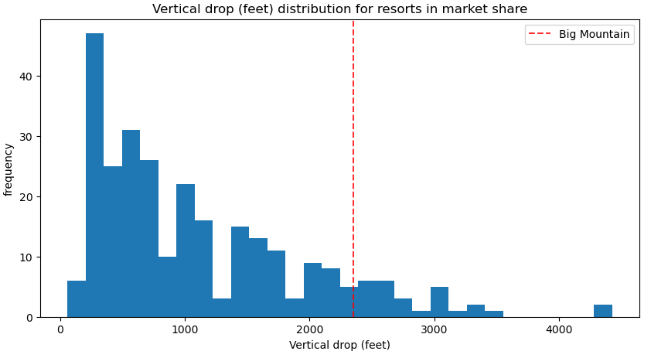
Modeling Results and Analysis
Big Mountain Resort is doing well for vertical drops but there are other resorts with greater drops.

Slide 4
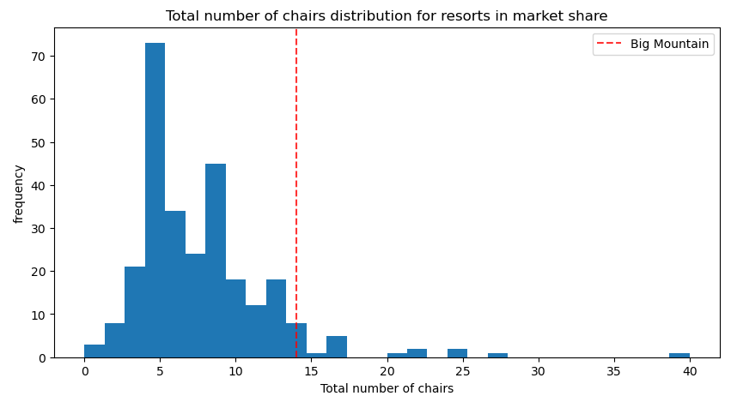
Big Mountain Resort has the highest number of total chairs, other resorts with more seem to be outliers.

Slide 5
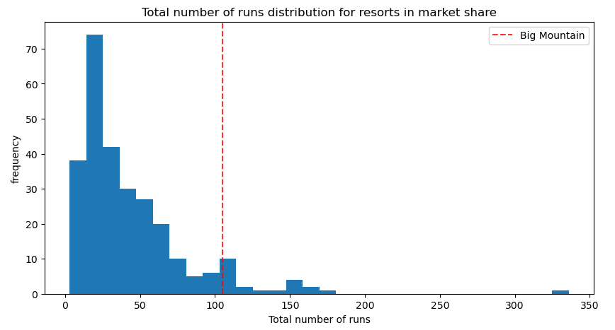
Big Mountain Resort compares well for the number of runs, only a few resorts have more.

Slide 6
Summary
We tested 4 different scenarios which the business has shortlisted while assuming the expected number of visitors over the season are 350,000 and visitors, on average, ski for five days. We also assumed the provided data includes the additional lift that Big Mountain Resort had recently installed.
Conclusion
We suggest Big Mountain Resort to implement scenario 2, the model shows that this increases the support for ticket price by $1.99. Over the season, this could be expected to amount to $3,474,638 in profit.

